Slide 1


Prayer points
Pray with us ahead of assisted suicide votes in Westminster and Holyrood
May 2025

Slide 2
Pray for the vulnerable in society
For he will deliver the needy who cry out, the afflicted who have no one to help. He will take pity on the weak and the needy and save the needy from death. Psalm 72:12– 3
Pray for a revival of compassion in our society, that we would prioritise caring for the sick instead of seeking to help them end their lives.
Pray that those living with a disability would be able to access support in the community that enables them to live a full and fulfilled life.
Pray for women in abusive relationships that are vulnerable to assisted suicide becoming law. Pray they would have routes of escape, either through a local refuge, the church or extended family.
Pray trust between ethnic minority communities and clinicians would grow and access to end-of-life palliative care provision would significantly improve in this nation.
Pray for family members who give their time and resources to care for loved ones who are unwell or long-term sick.

Slide 3
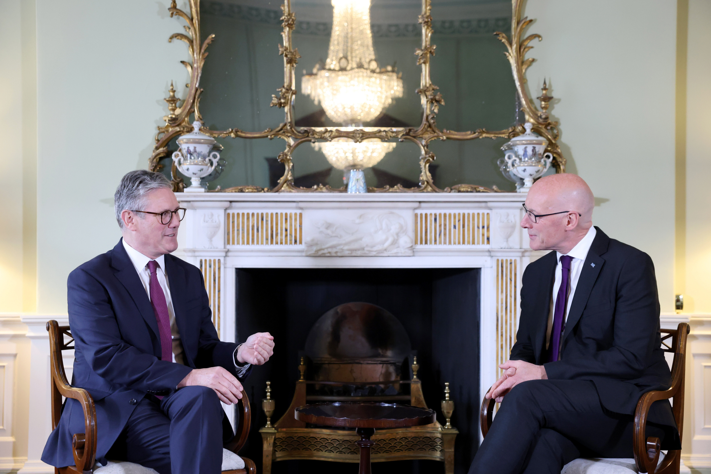

Praying for those in politics
Let everyone be subject to governing authorities, for there is no authority except that which God has established. The authorities that exist have been established by God. Romans 13:1
Pray politicians would seek to do the will of the Lord when it comes to health and social care.
Political leaders wield significant influence and authority. Pray for prime minister Keir Starmer, health and social care secretary of state Wes Streeting, first minister of Scotland John Swinney and cabinet secretary for health and social care in Scotland Neil Gray. Pray that they would yield earthly power, encounter Christ and surrender to His sovereignty and will.
Pray for boldness for Christian politicians as they give speeches in the debate. Pray what they share would come from the heart of God, exposing the lies of autonomy around these bills and bring truth to this issue.

Slide 4
Pray for the health and social care sector
I have seen their ways, but I will heal them; I will guide them and restore comfort to Isreal’s mourners, creating praise on their lips. Peace, peace, to those far and near,” says the LORD. “And I will heal them. Isaiah 57:18–19
The health and social care sector has been significantly shaped by Christian values and the truth of scripture. Pray our health and social care services would continue to be a service of care, not death.
Pray for the spiritual and mental wellbeing of nurses, doctors and palliative care specialists who are working long hours and in pressured situations.
Give thanks for the Association of Palliative Medicine and their courage to speak out against Kim Leadbeater’s bill during committee stage. Pray their concerns would be heard by those politicians undecided in how to vote.

Slide 5

Pray for Christians working in care
The Lord sustains them on their sickbed and restores them from their bed of illness. Psalm 41:3
I needed clothes and you clothed me, I was sick and you looked after me, I was in prison and you came to visit me. Matthew 25:36
Give thanks for Christians leading hospice care and care homes across this nation. Pray for the long-term funding of end-of-life care in the community.
Pray against proposals that demand assisted suicide to be carried out in hospices and care homes.
Bring before the Lord the local hospice and care home in your community. Ask the Lord to provide for the staff and residents.

